Slide 1

What is Test-Driven Development (TDD)?
Definition: Test-Driven Development is a testing methodology, or a programming practice implemented from a developer’s perspective. In this technique, a QA engineer starts designing and writing test cases for every small functionality of an application. This technique attempts to answer a simple question – Is the code valid?
The main intention of this technique is to modify or write a fresh code only when the test fails. Hence it results in lesser duplication of test scripts. This technique is largely popular in agile development ecosystems. In a TDD approach, automated test scripts are written before functional pieces of code

Slide 2
Following steps in TDD methodology
Based on the requirements specified in the documents, a developer writes an automated test case
These tests are executed, and in some cases, they fail as they are developed before the development of an actual feature
The development team then re-factors the code for the test to pass successfully.
Note: Code Re-factoring refers to the process of modifying the code without changing its main functionality or behavior.

Slide 3
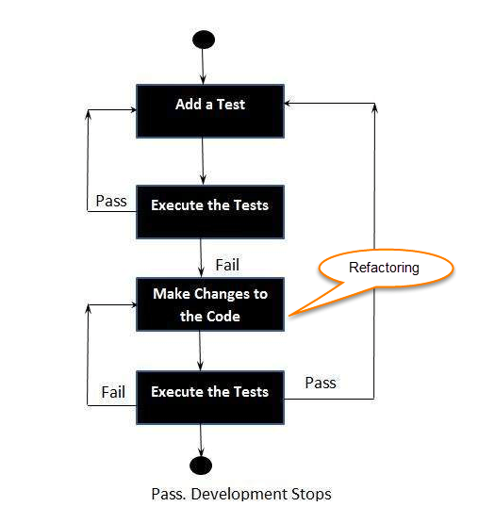
TDD flow chart

Slide 4
Advantages of Test-Driven Development:
Helps reduce the amount of time required for rework
Helps explore bugs or errors very quickly
Helps get faster feedback
Encourages the development of cleaner and better designs
Enhances the productivity of the programmer
Allows any team member to start working on the code in the absence of a specific team member. This encourages knowledge sharing and collaboration
Gives the programmer confidence to change the large architecture of an application easily
Results in the creation of extensive code that is flexible and easy to maintain

Slide 5
What is Behavioral-Driven Development
Definition: Business-Driven Development (BDD) is a testing approach derived from the Test-Driven Development (TDD) methodology. In BDD, tests are mainly based on systems behavior. This approach defines various ways to develop a feature based on its behavior. In most cases, the Given-When-Then approach is used for writing test cases.
Example for better understanding:
Given the user has entered valid login credentials
When a user clicks on the login button
Then display the successful validation message

Slide 6
Advantages of BDD approach
Strong collaboration. With BDD, all the involved parties have a strong understanding of the project and they can all have a role in the communication and actually have constructive discussions. BDD increases and improves collaboration. It enables everyone involved in the project to easily engage in the product development cycle. And by using plain language, all are able to write behavior scenarios.
High visibility. By using a language understood by all, everyone gets a strong visibility into the project’s progression.
The software design follows business value. In fact, BDD puts a great importance to the Business value & needs. By setting priorities with the client, based on the value it provides, developers are able to provide better result because they have a strong understanding of how the client thinks. By focusing on the value, no useless features are built.
The ubiquitous language. As mentioned earlier, the ubiquitous language is understandable by all the members of the team, which reduces misconceptions and misunderstanding and makes it easier for new members to join the working process.
Software development meets user need. By focusing on the business’ needs, you get satisfied users, and that implies a happy business of course. Actually with BDD, as its name says it, you focus on the behavior, which has a stronger impact than the implementation itself.
More confidence from the developer’s side. Teams using BDD are in general much more confident that they won’t break code and have better predictability when it comes to their work.
Lower costs. By improving the quality of the code, you are basically reducing costs of maintenance and minimizing the project’s risks.

Slide 7
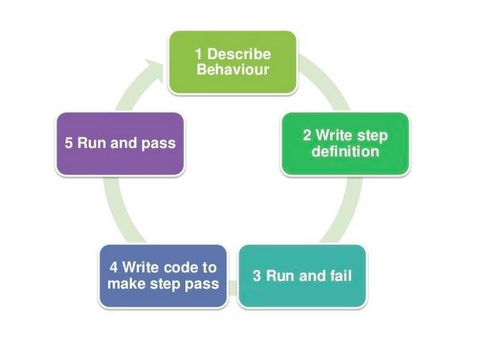
BDD flow chart

Slide 8
How does BDD help in SDLC?
Debugging the errors in the latter stages of the development life cycle often proves to be very expensive. In the majority of cases, ambiguity in understanding the requirements is the root cause behind this. One needs to ensure that all the development efforts remain aligned towards fulfilling pre-determined requirements. BDD allows developers to do the above by :
Allowing the requirements to be defined in a standard approach using simple English
Providing several ways to illustrate real-world scenarios for understanding requirements
Providing a platform that enables the tech and non-tech teams to collaborate and understand the requirements

Slide 9
Key difference between TDD and BDD
Parameters | TDD | BDD
Definition | TDD is a development technique that focuses more on the implementation of a feature | BDD is a development technique that focuses on the system’s behavior
Participants | Developer | Developers, Customer, QAs
Language used | Written in a language similar to the one used for feature development (Eg. Java, Python, etc) | Simple English, (Gherkin)
Main Focus | Unit Tests | Understanding Requirements
Tools used | JDave, Cucumber, JBehave, Spec Flow, BeanSpec, Gherkin Concordian, FitNesse | Gherkin, Dave, Cucumber, JBehave, Spec Flow, BeanSpec, Concordian

